Slide 1
CE889 Group Project
Rossman Sales Prediction
Team 5
Authors:
Thomas Sadler
Gayatri Kondapalli
Shashank Gurrala
Rohit Joshi
Prakash Dhakal
Ibad Rehman

Slide 2
Preprocessing the Data
Immediate observations
Initial Dataset
- Pre-processing decisions
Final Dataset

Slide 3
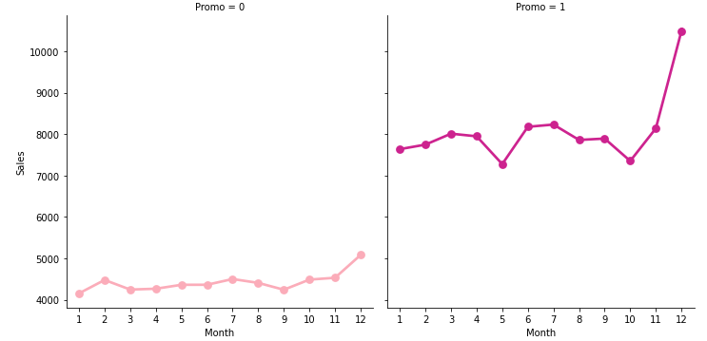
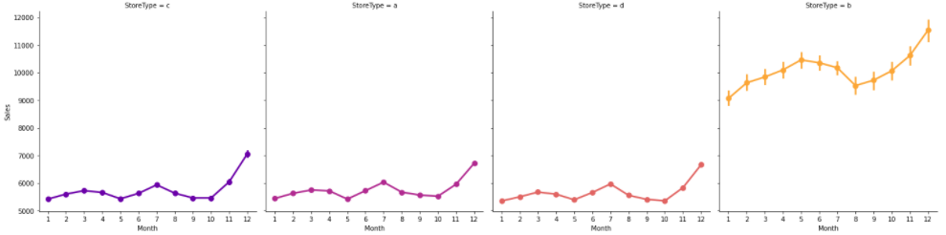
Data Observations
Distinguishing between variables that impact sales, and those that don’t
Distinct correlation between stores with an active promotion and those without
At least 20% of the data has 0 sales (not useful for time series prediction)
Store type implicates the sales success that store has I.e. Store B has the most sales on average
Sales escalate toward the end of the year around December time

Slide 4


Initial Dataset
Train CSV
Store CSV
Splitting the date – From date object to single integers interpreted individually
→
WeekOfYear – another way to help us visualize sales patterns through the year and is required for a future calculation
Date Column was dropped as it was no longer useful

Slide 5
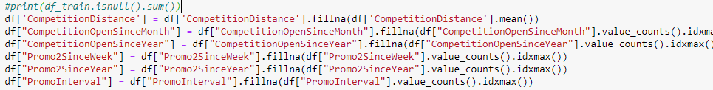
Preprocessing Decisions
Filling Nan values in the data set
- Categorical / Date based values – Filled with the most frequent value in the column
- Numerical values – Filled with the mean of the entire column
Idea was to keep the doctored values as average as possible without the disturbing the trend of the entire dataset
Potential Outliers and anomalies created as a result of this process would have altered trends in the data and potentially skewed predictions

Slide 6



Preprocessing Decisions
Handling Categorical Data
State Holiday – 0, a, b, c → n, a, b, c
Essentially assigning a unique integer to each unique column value using alphabetical ordering
Label encoding was used as opposed to one hot encoding
It’s not necessary with this kind of data to create multiple new columns for each unique value
The dataset shape would become unnecessarily large
→

Slide 7



Preprocessing Decisions
Implemented a form of feature engineering Converting multiple columns into a single one
It’s good to condense information where you can without losing or compromising the effect of any data
→
→
We then dropped the initial four columns from the dataset
The next step was to remove rows where the open column is set = 0
We are dealing with time series forecasting. It’s not necessary to predict that a store will have 0 sales when it’s closed.
We then dropped the “Open” column as it was no longer useful (Only 1’s)

Slide 8

Preprocessing Decisions
The shape of the training data and the testing data must be the same to work with our neural network
“Id”
“Customers”
We can’t predict the number of customers we will have in 6 weeks anyway
The final step was to normalize the data – the network cannot handle such a high variance of values especially at their size
Not to mention it takes care of any potential outliers or anomalies

Slide 9
Final Dataset
Training Data frame & Testing Data frame
Final Columns:
Store
DayOfWeek
Sales
Promo
StateHoliday
SchoolHoliday
StoreType
Assortment
CompetitionDistance
Promo2
PromoInterval
Year
Month Day
WeekOfYear
CompetitionOpen
PromoOpen

Slide 10

Creating and implementing our Architecture
- Choice of architecture
- Architecture Design
- Hyperparameter Tuning

Slide 11
Architecture Choice
Designed the architecture using RNN(Recurrent Neural Networks) with LSTM(Long Short term memory).
Why RNN for Time Series?
RNNs are a powerful and robust type of neural network and belong to the most promising algorithms in use because it is the only one with internal memory. In a traditional neural network, we assume that all inputs (and outputs) are independent of each other. However, in our case to predict the Sales for the next 6 weeks, the previous data have to be memorized or considered to predict the next outcome. Recurrent neural networks add the immediate past to the present which makes them best in forecasting time series data.
These research papers below strongly suggest using RNN for time-series predictions:
https://www.sciencedirect.com/science/article/pii/S0169207020300996
https://www.researchgate.net/publication/330102696_Recurrent_Neural_Networks_for_Time_Series_Forecasting/link/5d9f2551299bf13f40d264a1/download

Slide 12
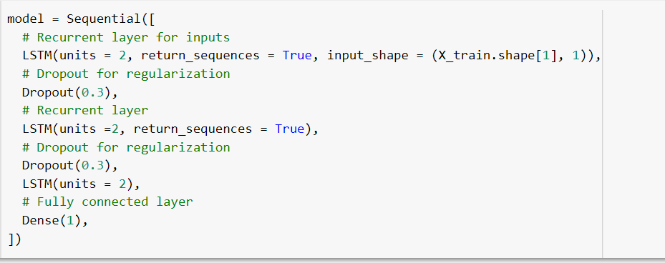
Architecture Design : Model

Slide 13
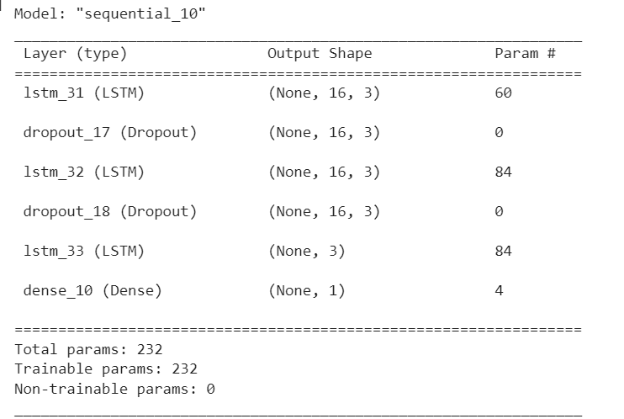
Architecture Design : Model Summary

Slide 14
Tuning of Hyper Parameters
Hyper Parameters used for tuning the model are
Dropout
Units
The number of LSTM layers in the design

Slide 15
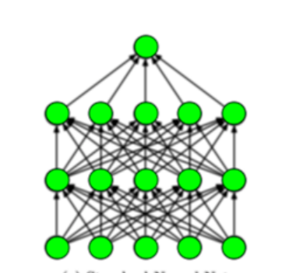
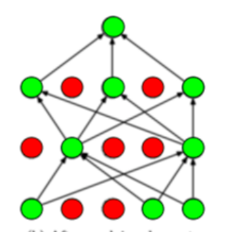
What is Dropout?
“Dropout” in machine learning refers to the process of randomly ignoring certain nodes in a layer during training. Dropout is used as a regularization technique — it prevents overfitting by ensuring that no units are codependent.
Standard Neural Network
Neural network with Dropout
Picture Reference:https://medium.com/analytics-vidhya/a-simple-introduction-to-dropout-regularization-with-code-5279489dda1e

Slide 16
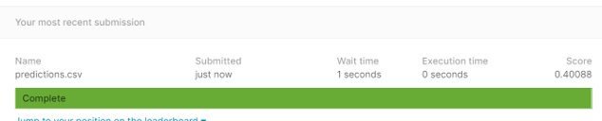
Tuning number of units
Number of units=2
Score on Kaggle:0.40088

Slide 17
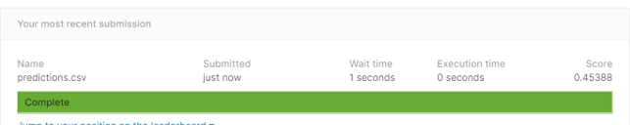
Tuning number of units
Number of units=3
Score on Kaggle:0.45388

Slide 18
Tuning number of LSTM layers
Number of LSTM layers = 3
Score on Kaggle:0.40088
Number of LSTM layers = 4
Score on Kaggle:0.45310

Slide 19
Neural Network Performance
Final Kaggle Score
Leaderboard Positions
Potential Network Improvements

Slide 20
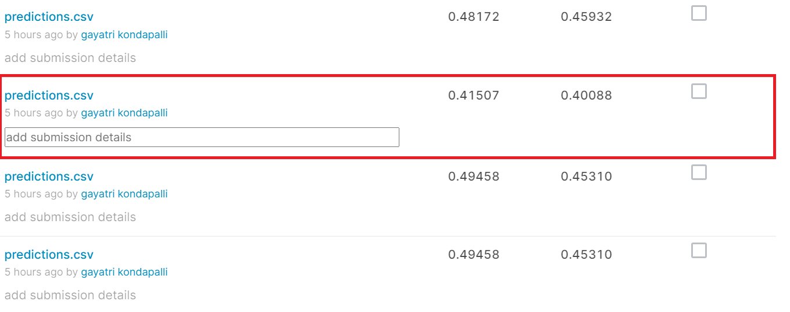
Final Kaggle Score
Best Score for the design on Kaggle is 0.40088

Slide 21
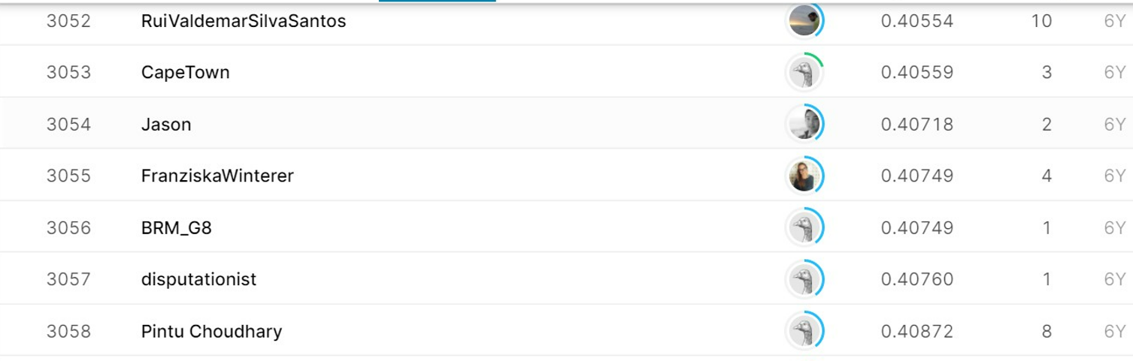
Leaderboard Score
Leaderboard rank might be between 3050 to 3200

Slide 22
Potential Network Improvements
Testing a few more hyperparameters might improve the network performance. The parameters like:
NUMBER OF UNITS IN A DENSE LAYER
Dense layers improve overall accuracy and 5–10 units or nodes per layer is a good base. So the output shape of the final dense layer will be affected by the number of neurons/units specified.
DECAY RATE
The weight decay can be added in the weight update rule that makes the weights decay to zero exponentially if no other weight update is scheduled. After each update, the weights are multiplied by a factor slightly less than 1, thereby preventing them from growing too huge. This specifies regularization in the network.

Slide 23
Individual Contributions
Thomas – Pre-processing Research, Architecture Research, Pre-processing Implementation, Architecture Implementation, PPT
Gayatri - Pre-processing Research, Architecture Research, Pre-processing Implementation, Architecture Implementation, PPT
Shashank – Pre-processing Research, Architecture Research, Architecture Implementation
Ibad – Architecture Research
Rohit - Architecture Research
Prakash - Architecture Research

